Slide 1
Bank Campaign Prediction 23 January 2019
Presented by:
Ayush Kumar Singh
Rahul Raj
Aniket Bhalerao
Puneet Kunder
Karan Bari

Slide 2
Background
A Marketing Campaign conducted by a Portuguese Bank based on phone calls to get their Bank Term Deposits approved.
The Customers, for this process were contacted more than one time to confirm if the product was Approved.
How our model can be beneficial to the bank.
We are trying to build the models without the use of the variable Duration(which contributes greatly to general models) as the duration of a call is not know before making the call. So using this model the bank should be able to decide whether or not to call the customer and minimize its losses.

Slide 3
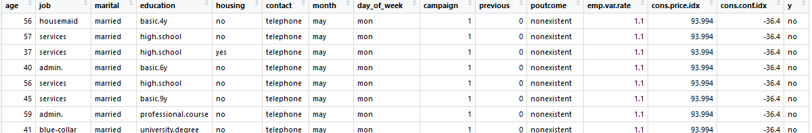
About the Dataset
As a part of the data set, we have some bank customer Demographics (Age, Education, Marital Status etc), how many times the customer was called during and before the current campaign and some other economic factors(e.g. employment variation rate)
Dataset has 41188 observations and 21 attributes ordered by date (from May 2008 to November 2010)

Slide 4
Important Attributes
Demographic attributes
Age, Job, Marital, Education and Housing
Bank campaign related details
Contact, Month, Day_of_week, Campaign, Previous and Poutcome
Economic factors
Emp.var.rate, Cons.price.idx, Cons.conf.idx

Slide 5
Project Objective
Our goal is to predict if the client will subscribe to the Bank Term Deposit(variable y).
To try and use combination of different ML algorithms and imbalanced data handling techniques to solve the problem.
Use different metrics to assess the models created.

Slide 6
Solution Proposed
Import Data
Logistic Regression
Understanding Data
Random Forest
EDA
Decision Tree
Comparing Results
Data Imputation
Naïve Bayes
Feature Selection
XgBoost
Final testing on test set
Model Building
SVM

Slide 7
Why Imbalanced Classes is a problem
Most real-world classification problems display some level of class imbalance, which is when each class does not make up an equal portion of your data-set.
For example, suppose you have two classes — A and B. Class A is 90% of your data-set and class B is the other 10%, but you are interested in identifying instances of class B. You can reach an accuracy of 90% by simply predicting class A every time, but this provides a useless classifier for your intended use case.
Instead, properly calibrated methods may achieve a lower accuracy, but would have a substantially higher true positive rate, which is really the metric you should have been optimizing for.

Slide 8
Generally there are two types of methods to deal with imbalanced class problem.
Cost based learning : Where we assign a particular cost for misclassification to the model.
Sampling based methods : Where we use different methods to sample the data to make the ratio of positive and negative classes comparable.
In this project we have focused on Sampling based methods to deal with the problem at hand and used the following methods along with different ML algorithms.
Under Sampling
Over Sampling
Synthetic Minority Oversampling TEchnique(SMOTE)

Slide 9
Design and Implementation
Unknown values imputation
attributes Job, education, marital and housing were having unknown values which were imputed using the mode of each attribute.
Correlation analysis
Based on correlation analysis attributes nr.employed and eurobor3 were dropped as they were highly correlated(>0.90) with the attribute emp.var.rate .
Attributes Loan and Default were dropped because one of the class in each attributed was distributed over more than 80% of the attribute, hence not much of the variance was explained by these variables.
Attribute Duration is dropped because from business point of view the duration of a call is not known before making the call, and usually the result is know after the call.

Slide 10
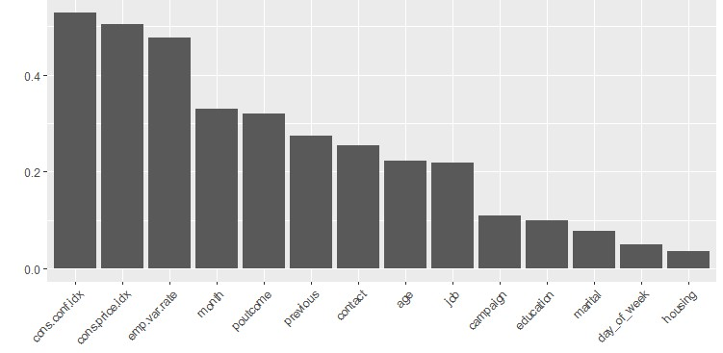
Attribute pdays is dropped when we check for attributes importance using chi-square. Below is the variable importance graph.
After performing the
Variable imputation and
Selection below attributes
were selected.
Demographic attributes
Age, Job, Marital, Education
Housing
Bank campaign related details
Contact, Month, Day_of_week, Campaign, Previous, Poutcome
Economic factors
Emp.var.rate, Cons.price.idx, Cons.conf.idx

Slide 11
ML Algorithms Used
Random Forest
Decision Trees
Logistic Regression
Naïve Bayes
SVM
xgboost
Every one of these algorithms has been used with the combination of sampling techniques to see which of the combination works better on our dataset.
As Accuracy can be misleading with imbalanced dataset, we have used precision recall and AUC as the evaluation metrics.

Slide 12
The project has been done in R statistical tool.
Some of the libraries used
caTools : for test train split.
ROSE : for sampling techniques and for calulating evaluation metrics
Rpart : to create the decision trees.
Caret : generate the confusion matrix
randomForest : to create randomforests
DMwR : SMOTE data generation
Xgboost : to implement xgboost algorithm
data.table : to convert a data frame to a table which is exceptale by xgboost
E1071 : to implement Naïve Bayes and SVM
Mlr : for parameter tunning
Corrgram: for correlation analysis
Ggplot2 : EDA through graphs.

Slide 13
Logistic regression Results:
Base model : TP: 131, FP: 49, FN:774, TN: 7063
Precision: 0.728, Recall: 0.145, F-measure: 0.121, AUC: 0.751
Undersampled model : TP: 529, FP: 871, FN:376, TN: 6241
Precision: 0.378, Recall: 0.582, F-measure: 0.23, AUC: 0.782
Oversampled model : TP: 529, FP: 871, FN:376, TN: 6241
Precision: 0.378, Recall: 0.582, F-measure: 0.23, AUC: 0.782
SMOTE model : TP: 526, FP: 847, FN:379, TN: 6265
Precision: 0.383, Recall: 0.581, F-measure: 0.231, 0.761

Slide 14
Decision Tree Results(algorithm used RPART):
Base model : TP: 154, FP: 83, FN:751, TN: 7029
Precision: 0.65, Recall: 0.17, F-measure: 0.135, AUC: 0.582
Undersampled model : TP: 547, FP: 1022, FN:358, TN: 6090
Precision: 0.349, Recall: 0.604, F-measure: 0.221, AUC: 0.756
Oversampled model : TP: 533, FP: 996, FN: 372, TN: 6116
Precision: 0.349, Recall: 0.589, F-measure: 0.219, AUC: 0.752
SMOTE model : TP: 511, FP: 897, FN: 394, TN: 6215
Precision: 0.363, Recall: 0.565, F-measure: 0.221, 0.751

Slide 15
Random Forest Results
Base model : TP: 209, FP: 135, FN:626, TN: 6430
Precision: 0.606, Recall: 0.253, F-measure: 0.178, AUC: 0.779
Undersampled model : TP: 528, FP: 1044, FN:307, TN: 5521
Precision: 0.336, Recall: 0.632, F-measure: 0.219, AUC: 0.781
Oversampled model : TP: 472, FP: 826, FN: 363, TN: 5739
Precision: 0.364, Recall: 0.565, F-measure: 0.221, AUC: 0.771
SMOTE model : TP: 472, FP: 672, FN: 363, TN: 5893
Precision: 0.413, Recall: 0.565, F-measure: 0.239,AUC: 0.786

Slide 16
Naïve Bayes Results
Base model : TP: 209, FP: 750, FN:461, TN: 6362
Precision: 0371, Recall: 0.49, F-measure: 0.423, AUC: 0.652
Undersampled model : TP: 558, FP: 1592, FN:347, TN: 5520
Precision: 0.259, Recall: 0.616, F-measure: 0.3653, AUC: 0.696
Oversampled model : TP: 528, FP: 1561, FN: 350, TN: 5551
Precision: 0.262, Recall: 0.613, F-measure: 0.367, AUC: 0.697
SMOTE model : TP: 517, FP: 1337, FN: 388, TN: 5775
Precision: 0.278, Recall: 0.5712, F-measure: 0.37441,AUC: 0.692

Slide 17
SVM results:
(radial kernel)
Base model : Precision: 0.8125, Recall: 0.147, F-measure: 0.249, AUC: 0.572
Undersampled model: Precision: 0.341, Recall: 0.670, F-measure: 0.452, AUC: 0.756
Oversampled model: Precision: 0.3617, Recall: 0.647, F-measure: 0.459, AUC: 0.748
SMOTE model :Precision: 0.356, Recall: 0.647, F-measure: 0.459, AUC: 0.752
(Polynomial kernel)
Base model : Precision: 1, Recall: 0.056, F-measure: 0.107, AUC: 0.528
Undersampled model: Precision: 0.472, Recall: 0.193, F-measure: 0.274, AUC: 0.583
Oversampled model: Precision: 0.367, Recall: 0.534, F-measure: 0.435, AUC: 0.715
SMOTE model :Precision: 0.425, Recall: 0.42, F-measure: 0.42, AUC: 0.65

Slide 18
XgBoost results:
Undersampled model : TP: 545, FP: 1013, 360, TN: 6099
Precision: 0.35, Recall: 0.602, F-measure: 0.221, AUC: 0.782
Oversampled model : TP: 521, FP: 1015, FN: 339, TN: 6142
Precision: 0.34, Recall: 0.607, F-measure: 0.222, AUC: 0.7828
SMOTE model : TP: 474, FP: 627, FN: 431, TN: 6485
Precision: 0.431, Recall: 0.524, F-measure: 0.236, AUC: 0.78

Slide 19
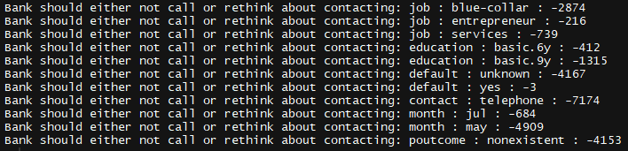
Insights
On an average per person, we have considered that the loss faced by the campaign per rejection is 1$ and gain a profit of 10$ per purchase of the product.
On that basis, we have segregated the attributes which the bank should avoid contacting or rethink about in terms of which category of people causes a loss to the bank.

Slide 20
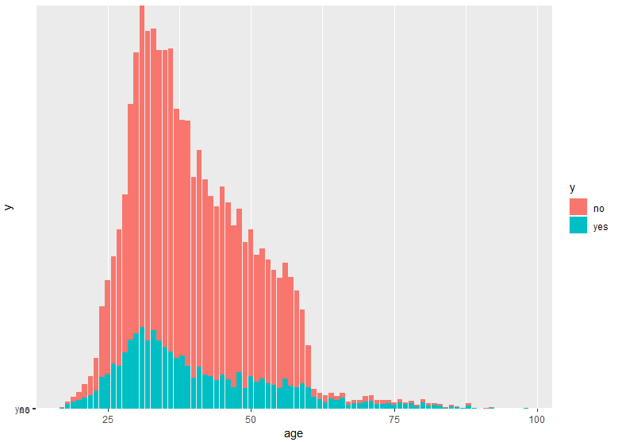
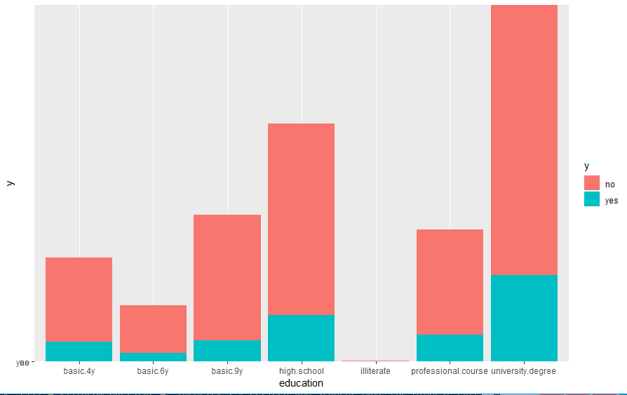
Age Distribution
Education distribution
The % of older people (above 60) and people between
the age Of (17-20) years have the higher tendency to
go for the bank deposit. These people should be a
priority target customers for the bank.

Slide 21
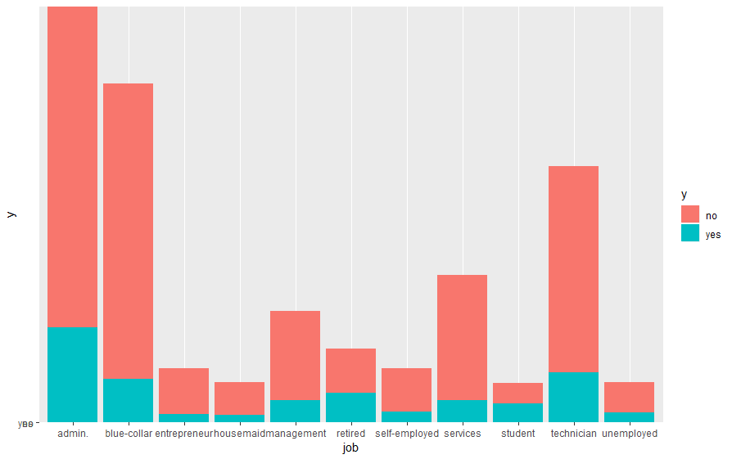
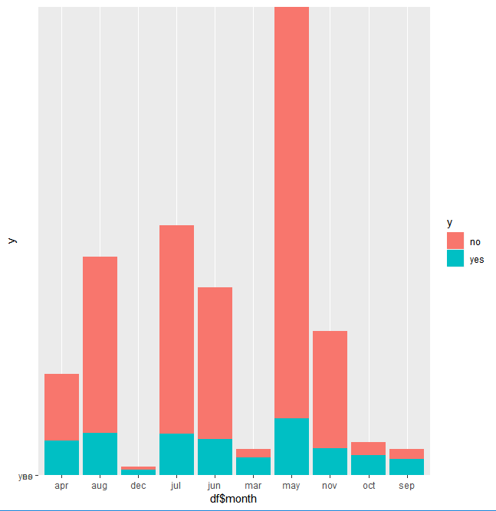
Job vs Marital Status
Retired and students category have the highest % .
of opting the campaign. This also coincides with our
Age distribution observation.
The month of Oct, Sep, Dec and Mar have the highest
% for the campaign success. This is the time for spring
And fall vacation, this period should be considered for calling
The respective customers.

Slide 22
Result and Interpretation
Evaluating the models based on Precision, Recall, F-measure and AUC.
Based on the above metrics the XGBoost model with oversampling should be considered as a better model because it has the highest AUC of 0.7828 and a recall of 0.607.
And, the random forest model with Under sampling which has the AUC of 0.78, and the recall of 0.632.
Recall is the measure, should try to maximize as it has the FN term in the denominator, which if is a huge value will cause the bank more loss, as it shows the positive class as negative (i.e. The customers who could have bought the product our model will classify them as they will not buy).
We tested the above two models on the test set for our final model selection.
Random Forest – Precision 0.332, Recall 0.645 and AUC 0.799
XGBoost – precision 0.35, Recall 0.63 and AUC 0.791.
Turns out Random Forest with undersampling has the best results.

Slide 23
Result and Interpretation
Cost Matrix:
Loss of 1$(average) per customer.
Profile of 10$ (average) per customer on success.
For TN there is no loss.
For FN there is a loss of 10$ per person
For FP there is a loss of 1$ per person
For TR there is a profit of 10$ per person
If we evaluate all the confusion matrix generated against this cost matrix then random forest with Undersampling works the best with the maximum profit.

Slide 24
Honor Code :
We pledge to maintain a high level of respect and integrity as students representing Aegis School of Business and Data Science. We understand and will uphold the Honor Code in letter and spirit to help our school advance authentic learning. We will not lie, cheat, plagiarize or be complicit with those who do.
I will encourage fellow students who commit honor offenses to acknowledge such offenses to their teacher or the Honor Council. I make this pledge in the spirit of honor and trust.
Contribution : All of us have contributed equally to the Project.

Slide 25


